Slide 1



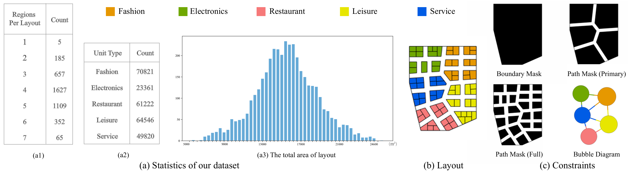
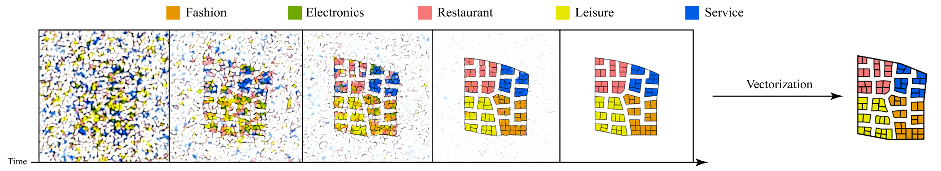
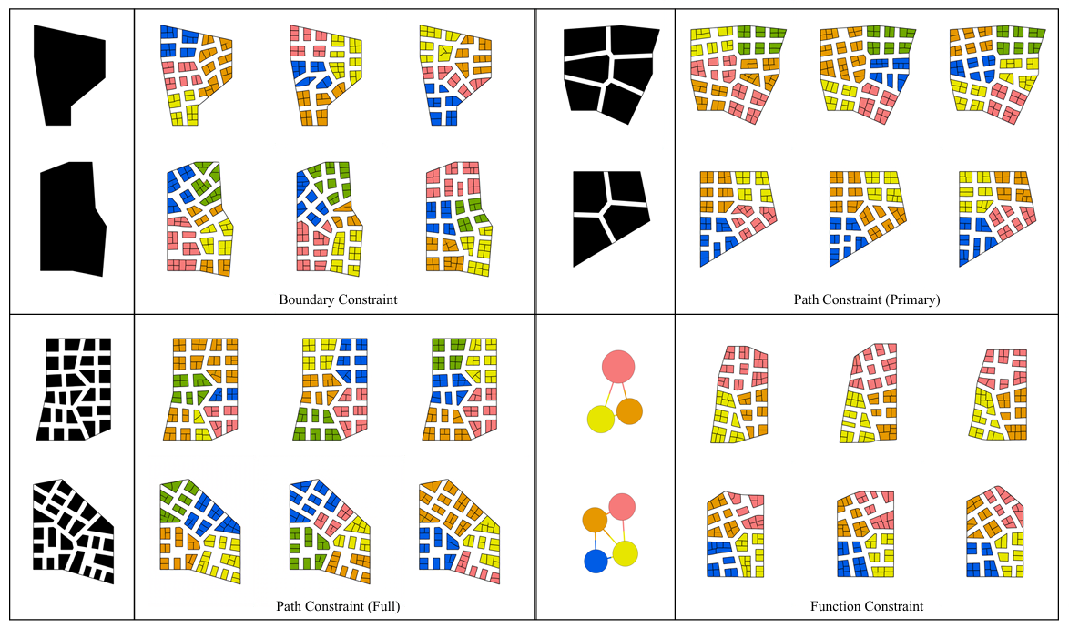
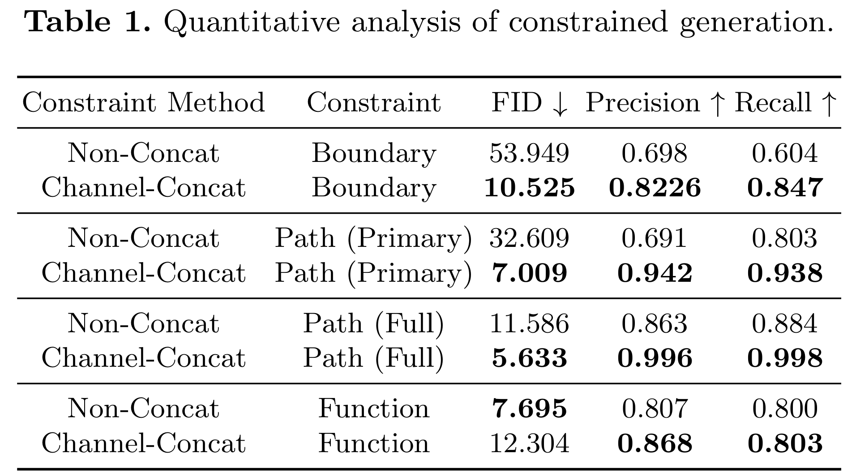
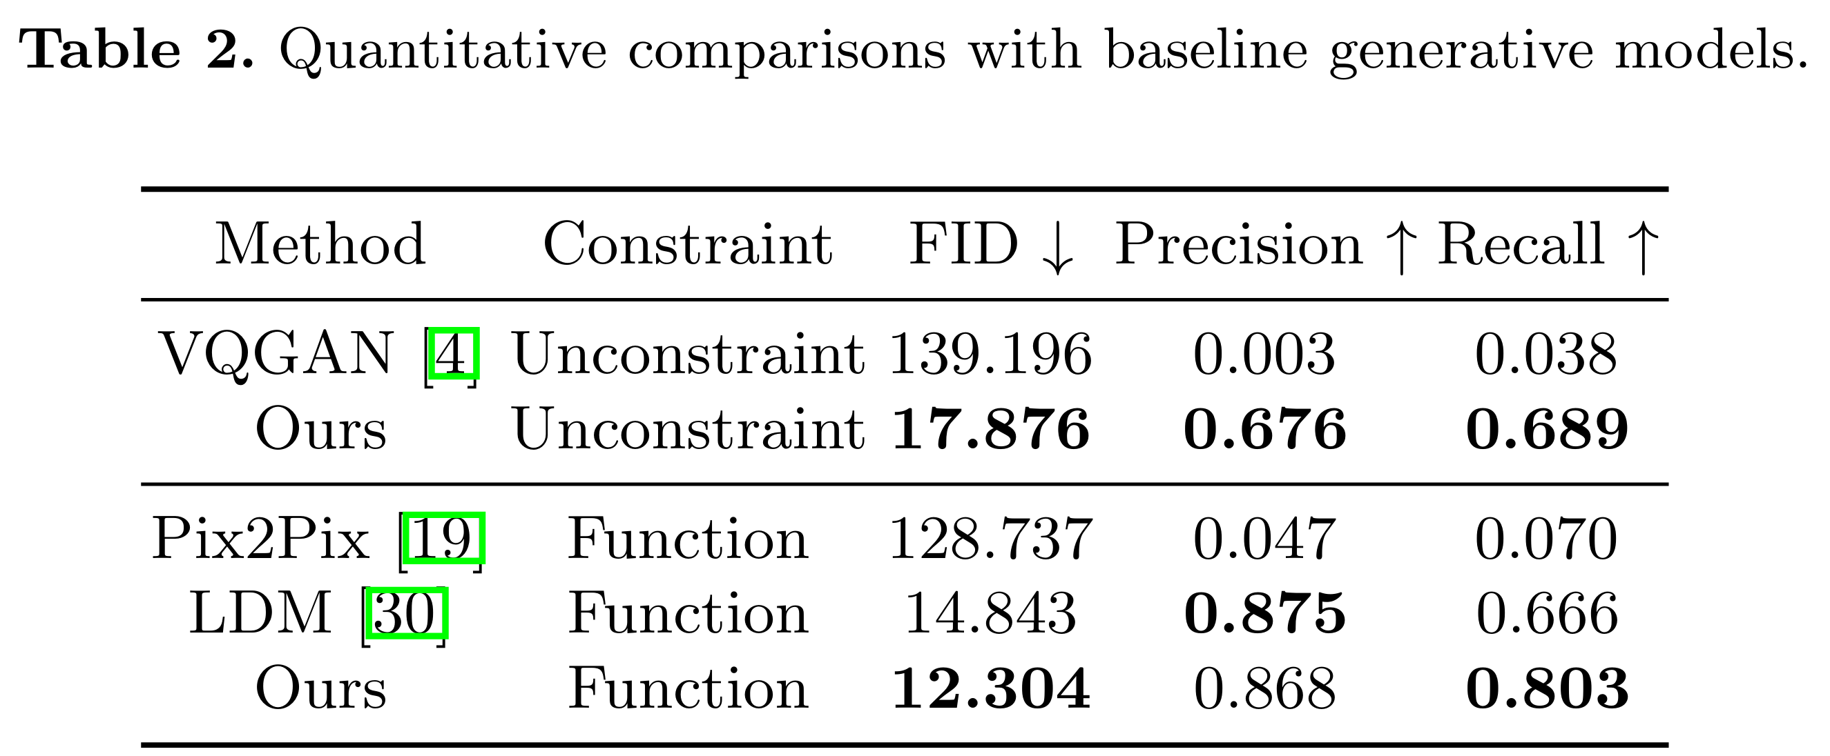
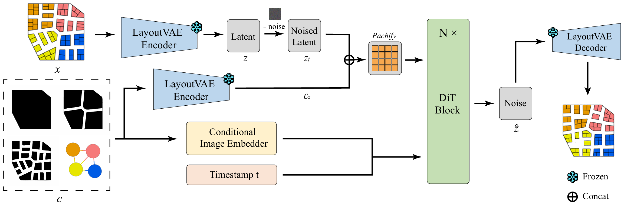
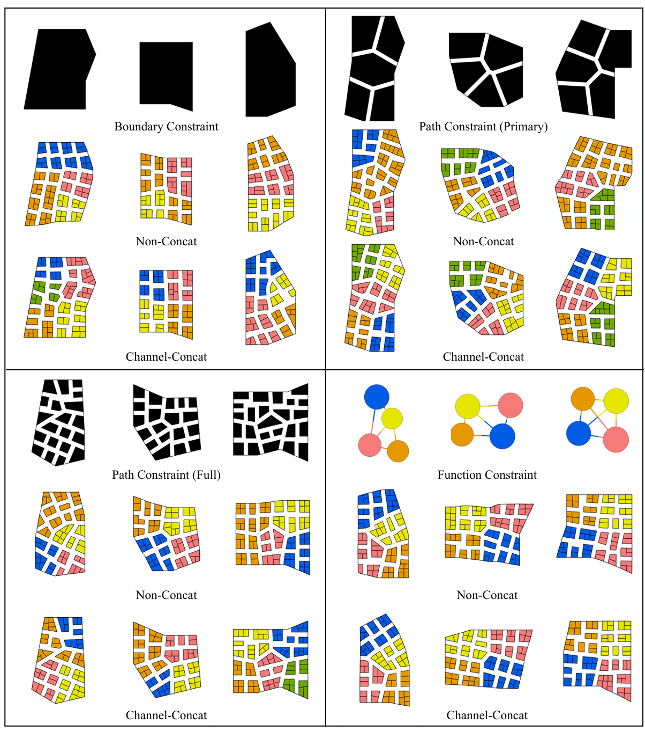
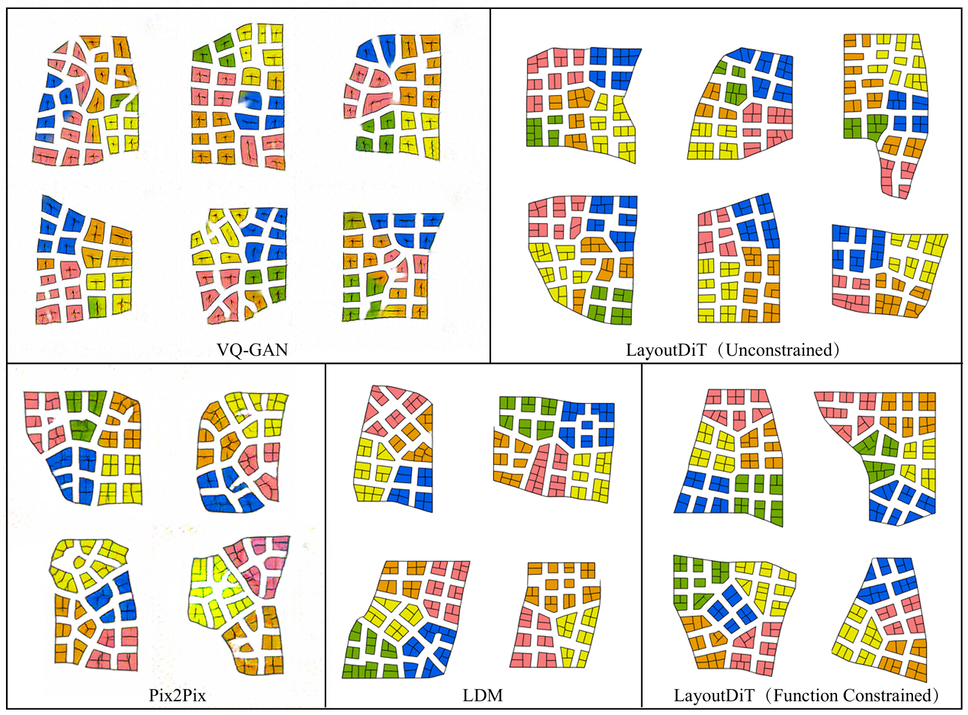
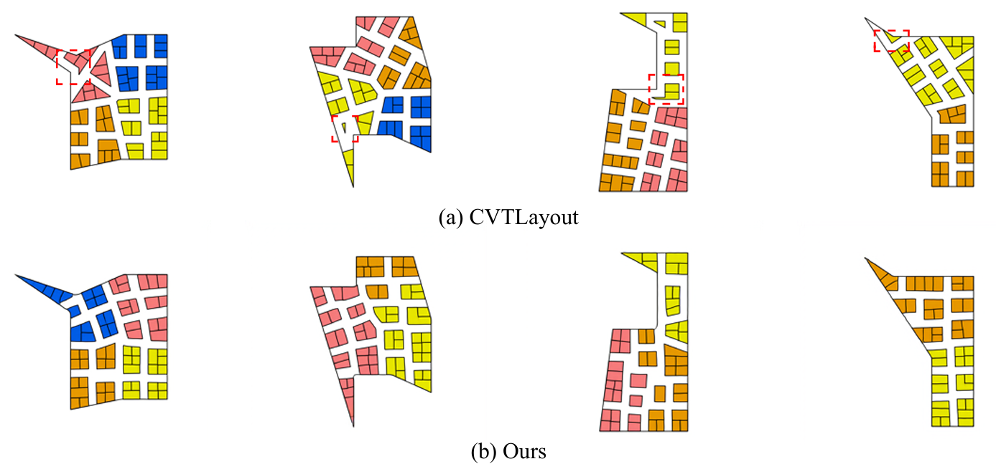
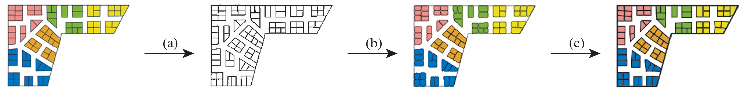
Synthesizing Commercial Floorplans via a Controllable Diffusion Framework
Wenming Wu, Yuntao Wang, Liping Zheng*
The 8th Chinese Conference on Pattern Recognition and Computer Vision, PRCV 2025
Homepage1
Homepage2
Abstract
Automatic generation of commercial floorplans can significantly improve spatial design efficiency and customer experiences. Traditional manual methods are labor-intensive, costly, and prone to inconsistency. While deep learning methods have shown promise, their application to commercial scenarios faces challenges, including limited datasets and insufficient controllability. To address these issues, we introduce a diffusion-based generative framework tailored specifically for commercial floorplan synthesis. We first create a synthetic dataset of diverse commercial floorplans using traditional geometric approaches. Then, leveraging a diffusion-based architecture, our method generates high-quality, realistic commercial floorplans. A subsequent vectorization step converts generated images into practical vector formats. Additionally, our approach supports practical constraints such as boundary masks, path constraints, and bubble diagrams, enabling precise and flexible control. Experiments demonstrate that our method outperforms existing generative models quantitatively and qualitatively. Our work represents a pioneering effort in applying diffusion-based generative methods to commercial floorplan design, providing a flexible and efficient solution for spatial designers.
Motivation
Dataset
Motivation: Layout design is vital across many fields. In commercial spaces like malls and hospitals, efficient layouts are crucial. However, manual design is slow and inconsistent, existing methods are complex and limited, and deep learning has not yet been effectively applied to commercial floorplans.
Challenges : Commercial floorplan generation faces three challenges: (1) Lack of public datasets for training and generalization. (2) Unique spatial and functional needs unlike residential or urban layouts. (3) High demand for controllability, such as boundaries, paths, and zoning.
Solution: We propose a diffusion-based framework for commercial floorplans. Using synthetic datasets, the model generates high-resolution layouts through progressive denoising. A vectorization step converts pixel layouts into clean, editable design drafts.
Public commercial floorplan datasets are scarce, so we build on RPLAN by extracting polygonal boundaries. To mimic realistic, irregular layouts, we sparsify vertices to create non-rectilinear contours, then apply CVTLayout to generate diverse, semantically meaningful floorplans. This pipeline produces 4,000 synthetic commercial samples.
Method
Experiment
Overview of our diffusion-based framework: starting from noise, the model progressively denoises over multiple timesteps to synthesize commercial floorplans; distinct colors denote functional zones, and the final raster layout is converted to a vectorized representation.
Controllable generation by image-based constraints：boundaries, primary/full paths, and bubble diagrams.
Our diffusion model ingests a layout image and a conditional image. The layout is encoded into a latent space and noised; the conditional input is (i) feature-encoded with the timestep for DiT conditioning and (ii) encoded into the same latent space for alignment. The conditional latent and noisy layout latent are concatenated, split into 16×16 patches, embedded as tokens, and processed by a Transformer, after which the predicted latent is decoded into a floorplan.
We benchmark against Pix2Pix, VQGAN, and LDM.
We compare two DiT conditioning schemes: Non-Concat (attention fusion) vs. Channel-Concat (constraints appended as extra channels).
Vectorization pipeline: (a) mask extraction with morphological cleanup; (b) contour detection and semantic classification; (c) polygon approximation and simplification.
We compare against CVTLayout, a optimization-based baseline.

